Slide 1
AIRFARE PREDICTION
Submitted By – Group 06
Sathyalakshmi N - PGCBAA03A048
Preeti Chandra - PGCBAA03A035
Sneha Velu Rajendran - PGCBAA03A018
Richa Singh - PGCBAA03A027
Shilpa Mridha - PGCBAA03A022
Sakthivel L - PGCBAA03A054

Slide 2


Content:
Objective of the Project
Description of the Problem
Data Source
Techniques and Analysis Implemented
Outcome and Inference
Ideology to transform and shape business

Slide 3

Objective of the project
To find the best fit model to analyse and predict ticket prices for upcoming flights.
To study the factors which influence the fluctuations in the airfare prices and how they are related to the change in the prices.
To help customers in selecting the optimum time to book and the cheapest flight to the desired destination.

Slide 4


Description of the Project
The problem of the project is the challenge of predicting airfare prices accurately. Airfare prices in the airline industry are known to be dynamic, constantly fluctuating based on various factors.
The price volatility makes it challenging for both airlines and travellers to make informed decisions regarding flight bookings.
Travelers often struggle to find cost-effective airfare options that align with their travel plans and budget..
Accurate airfare predictions can significantly benefit travel agencies and online booking platforms.

Slide 5

About the Data
The Dataset is well-structured and comprises 300153, offering a substantial volume of data for analysis.
Airline: The name of the airline company.
Flight: plane's flight code.
Source City: It represents the starting point of the journey.
Departure Time: It provides information about the departure schedule.
Stops: layovers between the source and destination cities. It indicates whether the flight is direct or has intermediate stops.
Arrival Time: It provides information about the estimated arrival time.
Destination City: City where the flight will land.
Class: The information on seat class.
Duration: the total time taken for the journey, including any layovers or stops.
Days Left: It represents the number of days between the booking date and the departure date.
Price: The information of the ticket price. This is the target variable for predictive analytics, and the aim is to predict this value based on the given features.

Slide 6
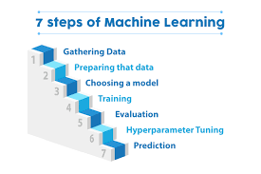
Techniques for Airfare Prediction Analysis
The project progressed through various stages, encompassing data collection, preprocessing, exploratory data analysis, feature selection and engineering, model development and evaluation. The following is a summary of the key components and methodologies employed in each stage:

Slide 7

1. Exploratory Data Analysis (EDA):
Descriptive Analytics
Duration Analysis: The average duration of flights in the dataset is approximately 12.22 hours, with a standard deviation of 7.19 hours. This indicates a considerable variability in flight durations.
Price Analysis: The average ticket price in the dataset is approximately 20,889.66, with a standard deviation of 22,697.77. This indicates a significant variation in ticket prices.

Slide 8
Missing Data Analysis: Our dataset do not have any null/nan/missing values.
Outliers Detection: For the 'duration' column, there are 722 outliers, which are flights with a duration greater than 30 hours. These outliers might be a result of layover stops between flights, including overnight layovers and flight cancellations. It is reasonable to have such outliers, so there is no need to remove them.
For the 'price' column, there are 602 outliers. These outliers might be due to natural price surges that occur, and they are not necessarily erroneous data points. Therefore, it is also not necessary to remove these outliers.
It seems that the outliers detected in the 'duration' and 'price' columns are valid and represent natural occurrences in flight durations and pricing.

Slide 9
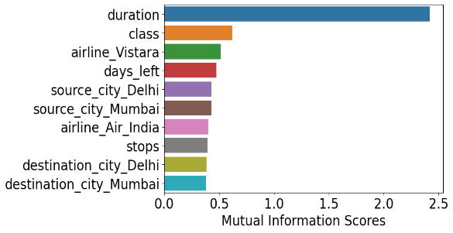
Feature encoding
One-Hot Encoding for Nominal Data- 'airline', 'source_city', 'departure_time', 'arrival_time', and 'destination_city'
Label Encoding for Ordinal Data-'Stops' and 'Class'
Feature Selection
Correlation Analysis: There is strong correlation with Class and Price.
Mutual information : The top features with higher mutual information scores were

Slide 10
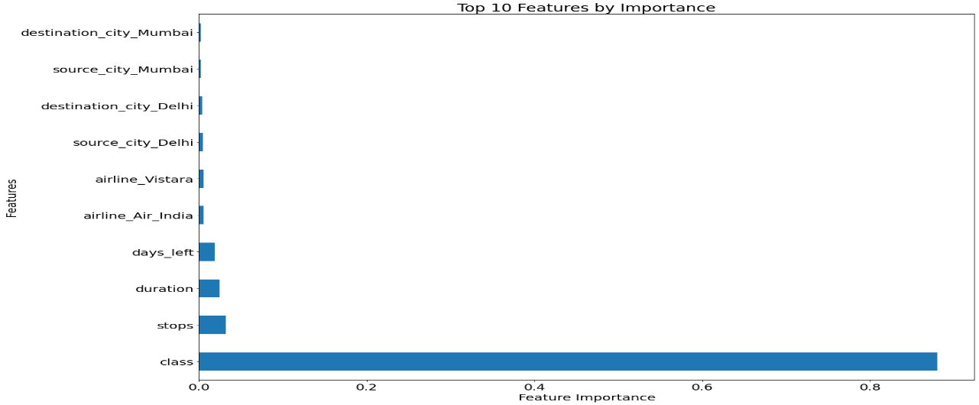
ExtraTreesRegressor: feature importance based on how much they contribute to the overall performance of the model.

Slide 11
Data Splitting
The dataset was divided into training and testing sets to assess the model's performance effectively
Normalization for Model Evaluation
Min-Max normalization was applied.

Slide 12
Model Building and Evaluation:
Linear Regression
Decision Tree
Random Forest
Model Name Mean_Absolute_Error R2_score
Linear Regression 4500.712502 0.909903
Decision Tree 1180.152502 0.975621
Random Forest 1085.251738 0.984743
Based on these findings, the Random Forest model emerged as the most promising for predicting flight prices, as it achieved the lowest MAE and highest R2 score among the three models.
Hyperparameter tuning
Model Name Mean_Absolute_Error R2_score
Linear Regression 4482.290304 0.909839
Decision Tree 1184.613697 0.975359
Random Forest 1083.512194 0.984781

Slide 13
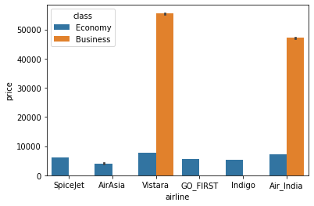
Outcome of the Project and Inferences Drawn:
Variation in Price with Airlines:
Business flights are only available in two companies: Air India and Vistara.
Economy Class Vistara is the most expensive and Air Asia is the least expensive whereas, in the Business Class, Vistara is the most expensive and Air India is the least expensive

Slide 14
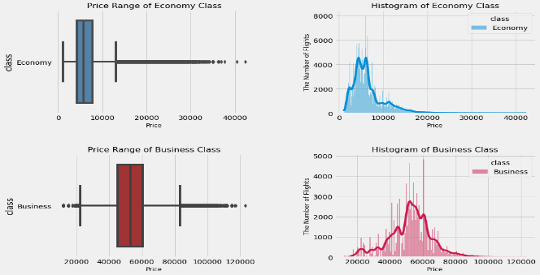
Ticket Price Variation between Economy and Business Class
Ticket prices vary between classes as the mean price of Business class tickets are almost 8 times of the mean price of Economy Class tickets.

Slide 15
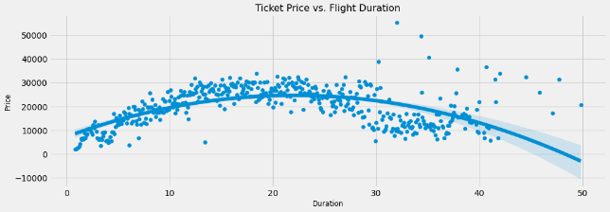
Price Variation with Duration
The Ticket price increases as the flight duration increases till 20 hours. After 20 hours, the ticket price decreases as the flight duration increases.

Slide 16
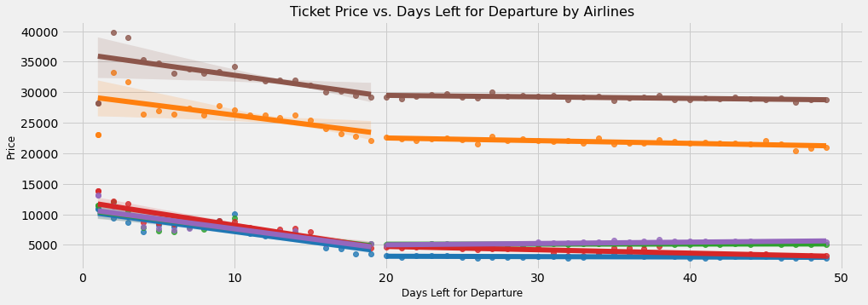
Price Variation with Days Left before Departure
It is recommended to purchase economy class tickets at least three weeks prior to departure and business class tickets at least ten days before departure.

Slide 17
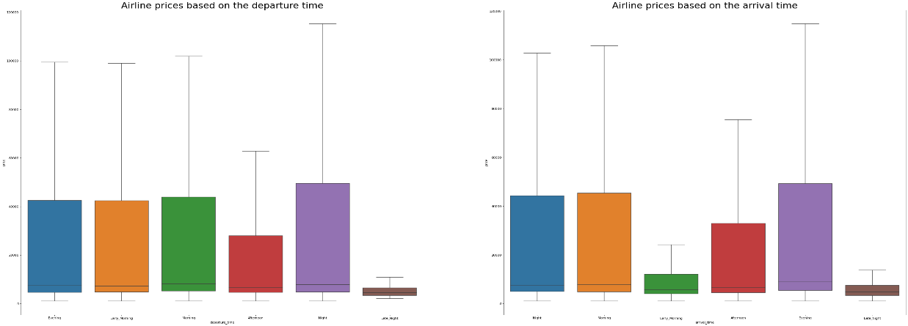
Price Variation based on Departure and Arrival Time
It indicates that ticket prices tend to be higher for economy class in the morning and lower in the evening. For business class, prices are higher in the morning and evening, and lower in the early morning and late night.

Slide 18
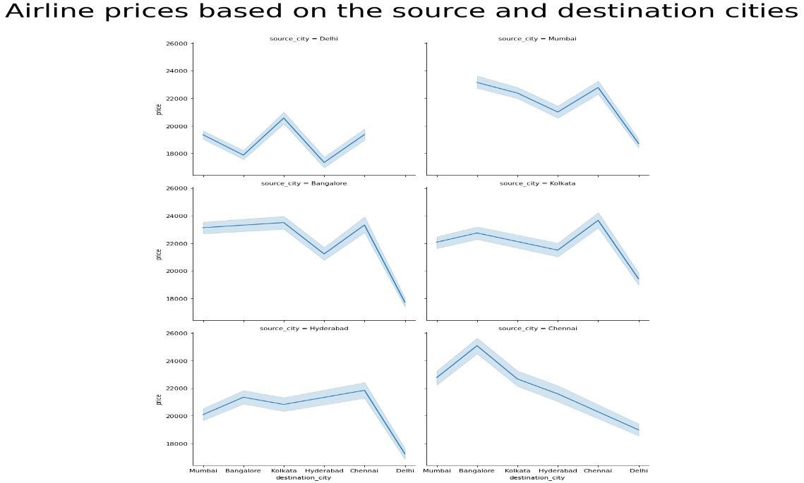
Price Variation based on Source and Destination
It suggests that flights leaving from Delhi are often cheaper than from other source cities.

Slide 19
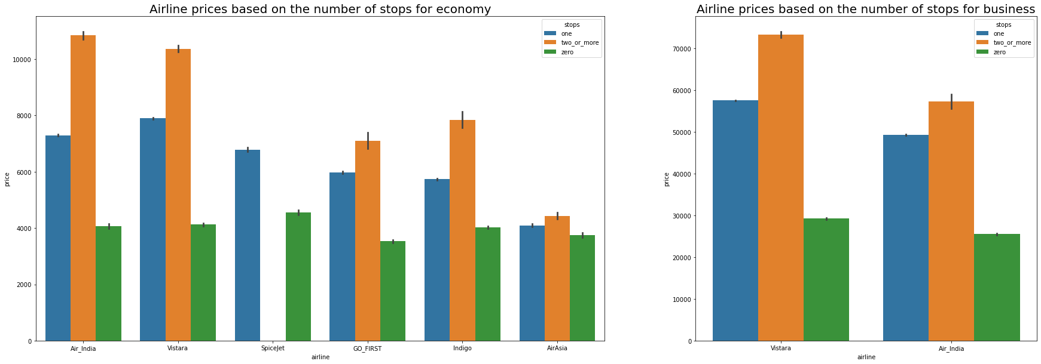
Influence of Number of Stops on Price
It indicates that more stops generally lead to higher ticket prices, except for AirAsia, where the prices are relatively constant.

Slide 20
How predicting flight prices benefits the business:
Revenue Optimization
Competitive Advantage
Customer Satisfaction
Improved Demand Forecasting
Pricing Strategies
Cost Optimization
Market Analysis and Insight
Limitation and Future Scope:
The exclusion of real-time information about seat availability and other important factors. By including real-time information about seat availability, the accuracy of the predictions can be improved.
The lack of practical implementation hinders the validation of the model's effectiveness and its ability to adapt to emerging challenges or changes in the airfare market. Future work or further research should encompass the deployment of the developed model in a production environment, along with ongoing monitoring and evaluation.

Slide 21

Conclusion:
The dataset is utilized to apply Machine Learning algorithms for the purpose of predicting the fluctuating fares of flights. This prediction allows customers to obtain estimated flight fare values in order to secure tickets at the lowest possible cost.

Slide 22

Thank you!

